Slide 1

Prototyping the system for paralel batch processing
Software Architectures and Database Systems
By Maciej Penar ©
mpenar@kia.prz.edu.pl

Slide 2
Agenda
(To piss off my colleage)
Classical database architecture
Zookeeper
Prototyping the system

Slide 3
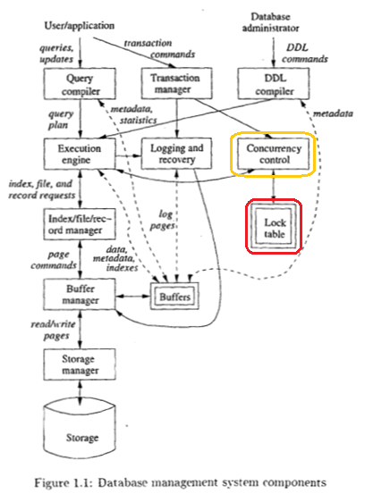

Database Architecture

Slide 4

Apache Zookeeper
System for coordinating the distributed applications:
In fact – Distributed Locking System
Set of primitives to operate on
Set of operations
It makes sense make the synchronization/coordination independent of application
At the point when You have distributed app, You should not mind further distribution
It is distributed OFC.
https://zookeeper.apache.org/
https://en.wikipedia.org/wiki/Distributed_lock_manager

Slide 5
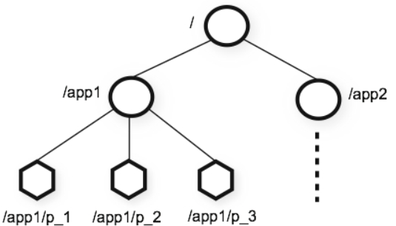
Apache Zookeeper
Data model
Basically, Zookeeper is a database which stores a tree
It makes sense to give a node per application in the top-level layer.
Because I say so!
https://zookeeper.apache.org/doc/r3.1.2/zookeeperOver.html

Slide 6
Apache Zookeeper
Nodes
Type of nodes (called znodes) which creates the tree are:
Persistent nodes – which are stored even when client disconnects
Ephemeral nodes – which are deleted when client disconnects
Sequential nodes – which are internally renamed from [name] to [name][number], the ZooKeeper guarantees that any two nodes does not have the same name. Sequential nodes can be persistent or ephemeral.
Znodes can hold up to 1 MB of data
https://www.tutorialspoint.com/zookeeper/zookeeper_fundamentals.htm

Slide 7
Apache Zookeeper
Guarantees
Sequential Consistency
Updates from a client will be applied in the order that they were sent.
Atomicity
Updates either succeed or fail. No partial results.
Reliability
Once an update has been applied, it will persist from that time forward until a client overwrites the update.
Single System Image
A client will see the same view of the service regardless of the server that it connects to.
Timeliness
The clients view of the system is guaranteed to be up-to-date within a certain time bound.

Slide 8
Apache Zookeeper
API
Operations:
CREATE – creates a node at a location in the tree
DELETE – deletes a node
EXISTS – tests if a node exists at a location
GET DATA – reads the data from a node
SET DATA – writes data to a node
GET CHILDREN – retrieves a list of children of a node
SYNC – waits for data to be propagated

Slide 9
Apache Zookeeper
Notes
Chubby

Slide 10
Prototyping the system
For the distributed calculations
What is the model of computations?
What is the payload of the system?
How system reads the data?
How system shares the data?
Can the work be decomposed?

Slide 11
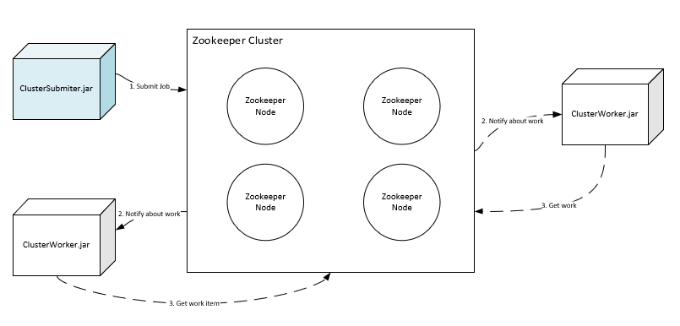
Prototyping the system
Computation model – example 1

Slide 12
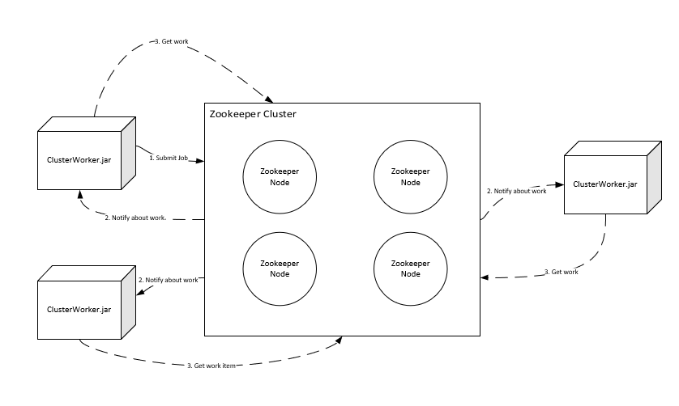
Prototyping the system
Computation model – example 2

Slide 13
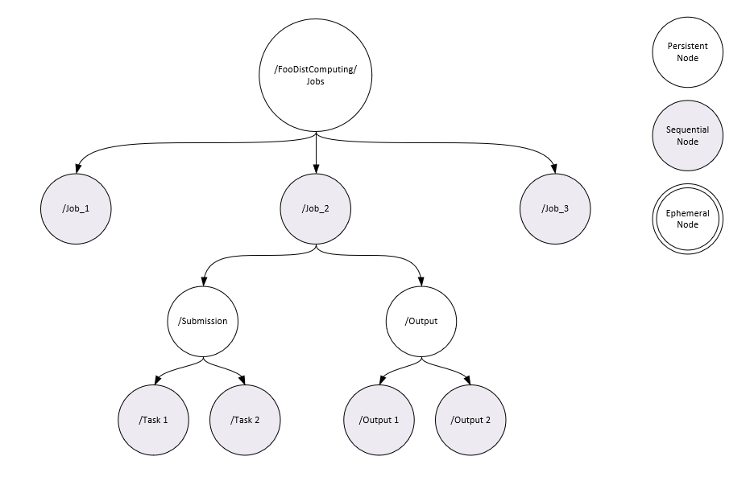
Prototyping the system
Data model – example 1

Slide 14
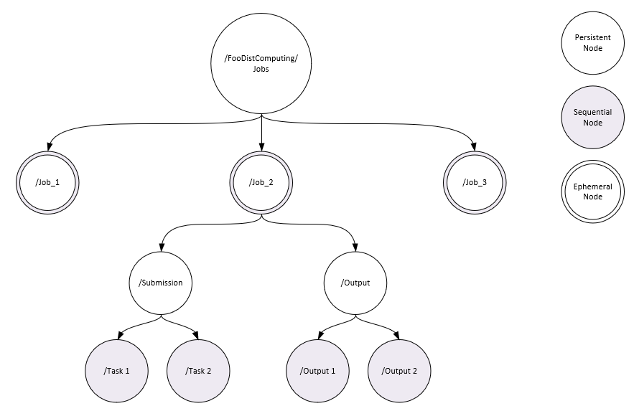
Prototyping the system
Data model – example BAD EXAMPLE
How to achieve such structure?

Slide 15
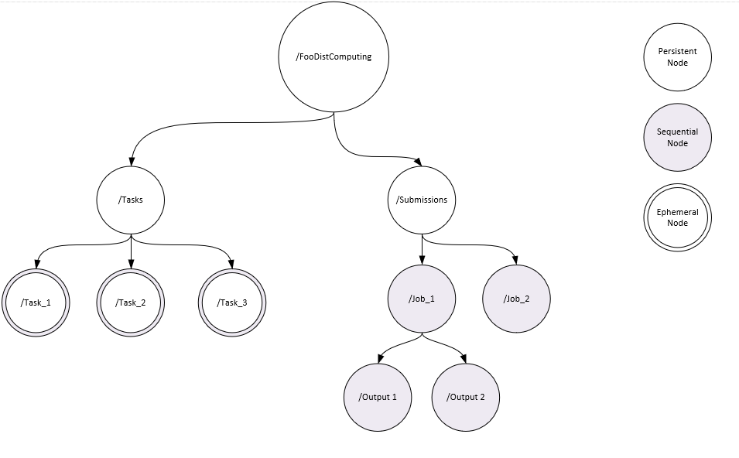
Prototyping the system
Data model – example 2

Slide 16
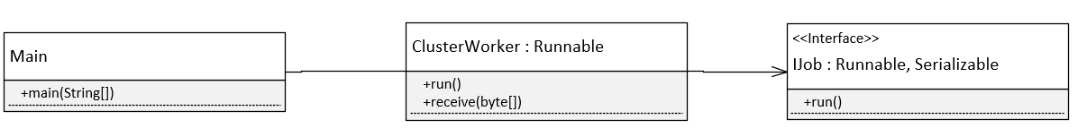
Prototyping the system
Program – only example

Slide 17
References
https://zookeeper.apache.org/
https://zookeeper.apache.org/doc/r3.1.2/zookeeperOver.html
https://www.tutorialspoint.com/zookeeper/zookeeper_fundamentals.htm
https://en.wikipedia.org/wiki/Distributed_lock_manager
http://glinden.blogspot.com/2006/09/chubby-google-distributed-lock-manager.html
https://zookeeper.apache.org/doc/r3.1.2/recipes.html

Slide 18
That’s all for now

